Slide 1
Solving Data-centric Tasks using Large Language Models
Shraddha Barke* , Christian Poelitz† , Carina Suzana Negreanu† , Benjamin Zorn† , José Cambronero†
Presented by: Nikhil Khanchandani

Slide 2
Table of contents
01
02
03
04
Introduction
What Are Data-Centric Tasks?
Techniques
The Role of LLMs

Slide 3
Table of contents
05
06
07
08
Use Cases
Limitations
Future Directions
Conclusion

Slide 4
01
Introduction
(AI)

Slide 5
Introduction
Data-centric tasks, such as cleaning, summarizing, and query generation, are needed but often require technical expertise
Tasks need to be performed with tools that require coding skills or advanced training
LLMs let non-technical users work with data through natural language

Slide 6
02
What are Data-Centric Tasks?
(AI)

Slide 7

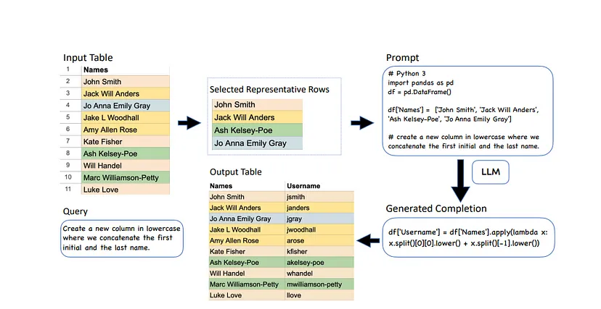
What are Data-Centric Tasks?
Examples:
Cleaning messy datasets.
Summarizing data
Writing code or queries for data analysis
Restructuring data into specific formats
Industries like finance, research, and Healthcare all rely on these tasks

Slide 8
03
Techniques
(AI)

Slide 9

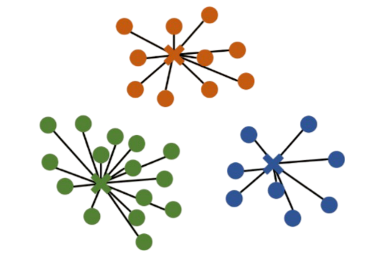
Techniques
StackOverflow or SofSet is used to solve these real-world problems by looking at the highest-rated posts and generating the correct pandas solution.
Cluster-then-select prompting technique which puts inputs in different clusters.

Slide 10
04
The Role of LLMs
(AI)

Slide 11
The Role of LLMs
LLMs understand natural language prompts, making data tasks intuitive.
Example Task: “Summarize sales data”
Capabilities:
Context understanding.
Flexibility for diverse tasks.
User Prompt
Clean Data Output
AI Processing

Slide 12
05
Use Cases
(AI)

Slide 13


Use Cases
Business: Automating financial reports, sales data summaries.
Research: Data preprocessing for experiments.
Education: Interactive tools for students learning data analysis.

Slide 14
06
Limitations
(AI)

Slide 15

Limitations
Dataset: Queries often only look at the relevant columns but many spreadsheets contain extraneous data which can lead to inaccuracy
Language: Results are based on only English StackOverflow posts
Clustering: The cluster-then-select technique might give different results from other methods

Slide 16
07
Future Directions
(AI)

Slide 17
Future Directions
Expanding datasets to include multilingual and more realistic scenarios.
Exploring hybrid models
Improving resource efficiency to make these tools more accessible
Integrating the LLMs with tools which show real-time visual feedback

Slide 18
08
Conclusion
(AI)

Slide 19

Conclusion
Recap: LLMs make data-centric workflows intuitive and accessible.
Potential across multiple industries.
The future of data.

